Slide 1
Implementing Cybersecurity tools and/or techniques in the reduction of cyberbullying: A meta-synthesis and systematic review
By Pearce Begley
16.10.2023
Notes:
Hello. My Name is Pearce Begley. This is a presentation describing in detail how I will collate research on the title ”Implementing Cybersecurity tools and/or techniques in the reduction of cyberbullying: A meta-synthesis and systematic review”.

Slide 2
Aims and objectives
The aim of this meta-synthesis and systematic review
  better understand cybersecurity tools and techniques used at reducing cyberbullying
  collate results on cybersecurity tools and techniques used to tackle cyberbullying
The objective is to discuss in detail how certain cybersecurity tools and techniques are implemented to address cyberbullying
(Doody & Bailey, 2016).
Notes:
To start with I have identified my aims and objectives. With any project is important to outline aims and objectives early on. By doing this it actually makes the research easier as there are specific goals. One of the aims of this research is to create a meta-synthesis and systematic review which understands the cybersecurity tools and techniques currently being used. Once an understanding of these cybersecurity tools and techniques used to tackle cyberbullying is reported, the meta-synthesis and systematic review will collate the data with the objective to clearly detail how cybersecurity tools and techniques can be implemented to reduce cyberbullying.

Slide 3
Why this research is important?
Cyberbullying is affecting millions of children and adults worldwide
UK statistics in cyberbullying are alarming e.g., 19% of 10-15year olds by March 2020 had experienced cyberbullying
Cyberbullying can have an effect on mental health
( Office of national statistics, 2020; Cook, 2023; Espalage & Hong, 2017).
Notes:
Why is this research important? Cyberbullying is affecting millions of children and adults worldwide. It is a public health concern as it can affect many aspects of a person's life including mental health, physical health and social life. In the UK alone cyberbullying affects 19% of 10-15 year olds according to the UK government from March 2020. This is almost 1 in 5 teenagers. This can have a detrimental effect on mental health and thus a knock on effect on multiple areas of life. For example education. If a person has mental health issues they are less likely to go to school and thus this has an effect on them getting their best education. Thankfully in the UK mental health is being discussed more and more, but this is not the case worldwide. Ipsos carried out an Interntional survey that questioned adults in 28 countries. They concluded that there are more parents aware of their own children experiencing cyberbullying in 2018 compared to 2011. Interestingly this was lower in Russia and Japan. This may be due to cultural differences but this will be discussed further in the systematic review and meta-synthesis. Another factor which will be discussed is the impact of the pandemic and how cyberbullying increased during this time. Multiple studies have shown an increase in hate speech in children and teenagers online since the pandemic with teenagers spending 17% more time online during pandemic. A study on Canadian teenagers found that individuals who experienced cyberbullying where at greater risk of depression, suicide, anxiety and risk behaviour. These statistics support the importance in discussing cybersecurity tools and techniques to help cyberbullying.

Slide 4
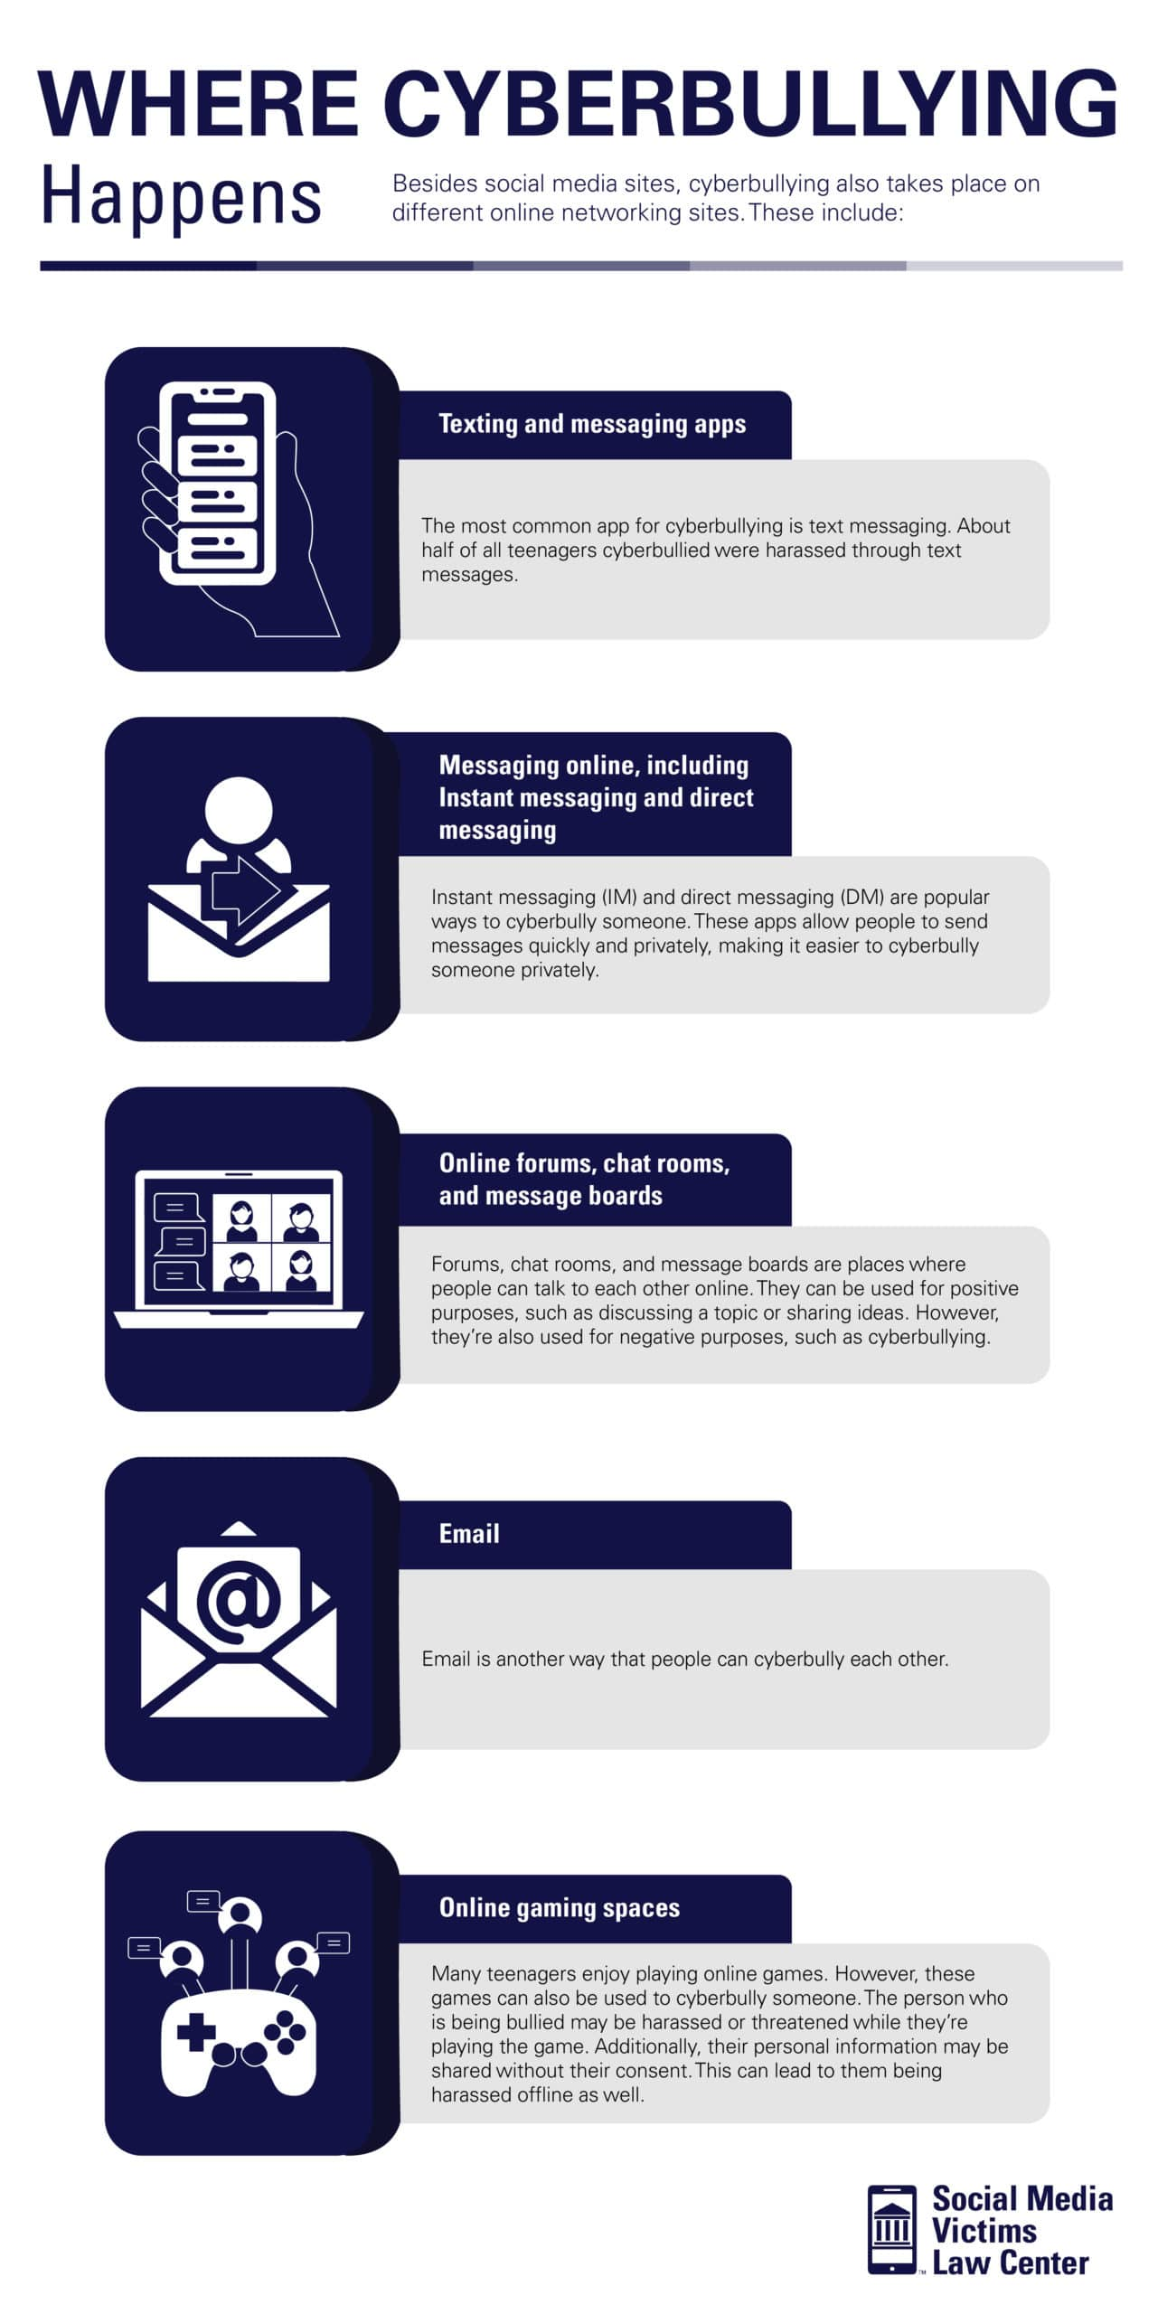
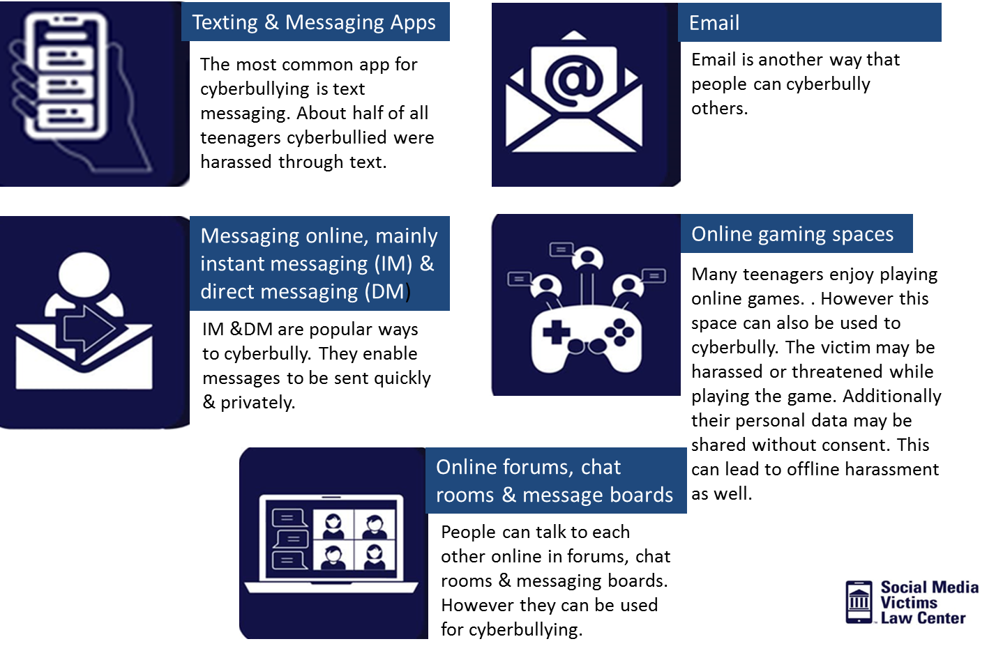
( Bergman, 2023).
Notes:
Where is cyberbullying happening? Most commonly cyberbullying occurs through text messaging but can also occur through direct message, instant message, email, gaming, forums, chat rooms and message boards. It is important to identify where the cyberbullying is happening as this will help in development of cybersecurity tools and techniques.

Slide 5




Key definitions and terminology
Cyberbullying
Meta-synthesis
Systematic review
Cybersecurity
(Corac 7 Kalstan, 2020; Chrastina, 2018,; Uman, 2011; National cyber security centre, No date) )
Notes:
Before we discuss more detail on how the study will be carried out, important terminology needs to be understood. Cyberbullying can be defined as "willful and repeated harm inflicted through computer, cell phones and other electronic device" (Corac and Kalstan 2020). Bullying has been around forever, but cyberbullying only first started in the 1990's with the development of the worldwide web. Cyberbullying has grown with the common use of smartphones. Many individuals who do commit cyberbullying often feel a level of anonymity as the bullying occurs behind a device. A meta synthesis will involve the systematic review and integration of findings from qualitative studies. Meta-synthesis can be defined a process using the meta-ethnography principles and concepts on qualitative data. The steps in carrying out a meta-synthesis will be discussed later. This area of research has only grown in last 20 years as there are more and more qualitative papers produced, meaning that the data needs to be analysed in a systematic way. It is also important to distinguish the difference between meta-analysis and meta-synthesis. Meta-analysis focuses on quantitative data whereas meta-synthesis, as said earlier, is for qualitative data. The difference between quantitative and qualitative data is that quantitative data focuses more on numbers or something that is a measurable piece of data whereas qualitative research is the interpretation of data which is related to language. A systematic review differs from a standard narrative review as it reviews journal articles that have been cumulated from a systematic search which I will disucss more later in presentation. The UK national cybersecurity centre defines "Cyber security is how individuals and organisations reduce the risk of cyberattack". Cybersecurity main function is to protect devices whether this be smartphone, laptop, tablets or other electronic devices.

Slide 6
Types of cybersecurity tools and techniques
Software
Tech healthy communication
Education
Smart home technology
Cyberaid
Social media tools
Government policies
(Governors for school, 2022; Espelage & Hing, 2017); Thun, 2022; Liam et al., 2022)
Notes:
From my preliminary research for this project I have concluded that the following cybersecurity tools and techniques can be used to help reduce cyberbullying; Software, Tech healthy communication, Education, Smart home technology, cyberaid, social media tools and governmental policies. Cybersecurity software can help tackle cyberbullying by monitoring activity and trying to detect bullying. Smoothwall is an example of a digital monitoring system used in UK schools and claims to find evidence of cyberbullying every 22 minutes. Prevention programmes for parents and children have recently been growing in popularity worldwide and have initially have positive effects. Before these programmes most parents received information from websites which often where promoting their own products and not backed up by peer-reviewed research. There is very limited peer-reviewed research into smart home technology and cyberbullying but it is important to realize that filters can be set. For example filters for obscene language. Cyberaid is a development of this in a way. Cyberaid is when cyberbullying detection tools are used to reduce cyberbullying. Some Cyberaid applications work by finding certain language e.g. hate speech and then asking them if they actually sure to send message as may have aspects of cyberbullying. Social media has a huge part of play in cyberbullying. There has been a clear correlation between social media growth and mental health issues. It has long been thought that social media platforms do not do enough to stop cyberbullying. In 2019 the UK government created the online harms white paper regulation framework which will help force social media companies by law to create safe environments online for individuals, especially teenagers.

Slide 7
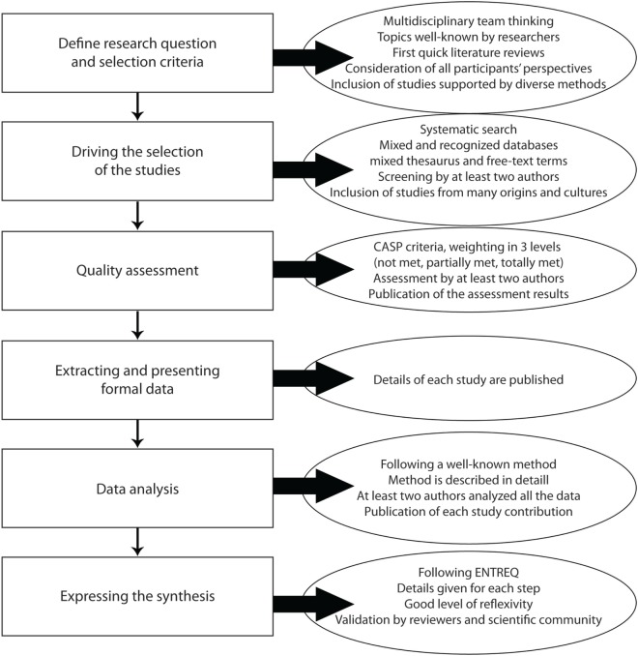
Methodology
Inclusion Criteria | Exclusion Criteria
Any research published after 2013 | Research published before 2013
Include all studies with individuals over the age of 8 | Studies which have individuals under the age of 8
All countries worldwide
All well individuals | Individuals with previous mental health problems identified
"cybersecurity" OR "cyber" or "security" OR "electronic information security" AND "tools" OR "techniques" OR "mechanism" OR "application" OR "device" OR "aid" OR "method" OR "strategy" OR "system“ AND "reduction" OR "reduce" OR "decrease" OR "lessen" AND "cyberbullying" OR "Trolling" OR "cyberstalking"
(Lachal et al., 2017)
Notes:
A six step process for a meta-synthesis is followed and can be found in the figure on the left of the slide. The method is described in six steps: define the research question and the inclusion criteria, select the studies, assess their quality, extract and present the formal data, analyse the data, and express the synthesis. By following this pathway it ensures scientific rigor. The research question is to find cybersecurity tools and techniques that can be implemented today to reduce cyberbullying. The inclusion criteria for the following studies is as follows
Research published after 2013. Cybersecurity has changed a lot since its first needed use in the 90s. To include research from the last 10 years this allows an amplitude of papers to be included but also means the papers are more specific and thus more relatable to each other.
To include all individuals over the age 8. From my preliminary research I could see that most research was only carried out on individuals older than 8. This is likely due to most people who use technology are over 8. However, it is important to factor in the age of children using smart devices is getting younger.
I have decided to include all countries research in this project. The reason for this is that there is limited research. By including all countries this allows for more research to included and thus compared.
Include all healthy individuals and exclude individuals who have already been identified as having a mental health problem. By excluding individuals with already identified mental health problems it gives the meta-synthesis and systematic review more reliability.
I did the search for studies on pubmed. I choose pubmed as it includes millions of articles from all over the world. The search was carried out Friday the 13th October and found 301 studies. The start of this list can be found on the next slide. The next step of the research study will be to assess the quality of data and extract the data needed. I will extract data into a table which will include age of participants, where the study was carried out, the tools/techniques used, year and findings. I will then analyse this data and format the qualitative data in a diagram; either a pareto, pie or bar chart.

Slide 8
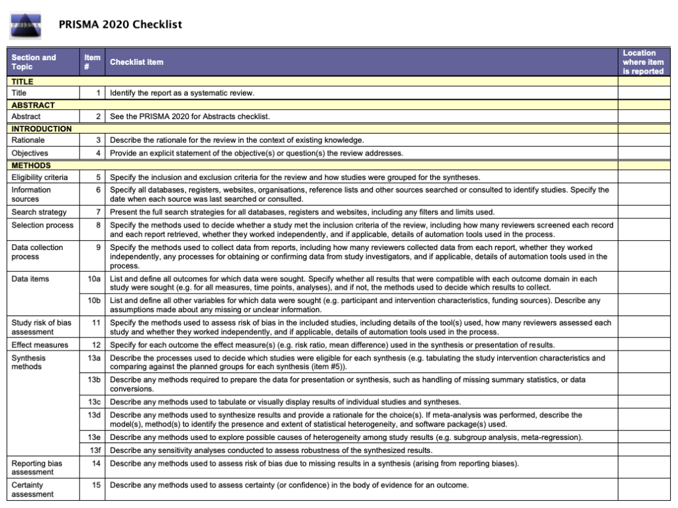
Methodology continued – Prisma 2020 Checklist
(PRISMA, 2020)
Notes:
For the systematic review I will use the PRISMA checklist to check all criteria has been met and thus giving scientific rigor to the research.

Slide 9
Methodology continued
1: Azúa Fuentes E, Rojas Carvallo P, Ruiz Poblete S. Acoso escolar (bullying)
como factor de riesgo de depresión y suicidio [Bullying as a risk factor for
depression and suicide]. Rev Chil Pediatr. 2020 Jun;91(3):432-439. Spanish. doi:
10.32641/rchped.v91i3.1230. PMID: 32730526.
2: Schonfeld A, McNiel D, Toyoshima T, Binder R. Cyberbullying and Adolescent
Suicide. J Am Acad Psychiatry Law. 2023 Mar;51(1):112-119. doi:
10.29158/JAAPL.220078-22. Epub 2023 Feb 23. PMID: 36822834.
3: Juvonen J, Graham S. Bullying in schools: the power of bullies and the plight
of victims. Annu Rev Psychol. 2014;65:159-85. doi: 10.1146/annurev-
psych-010213-115030. Epub 2013 Aug 5. PMID: 23937767.
(PRISMA, 2020)
Notes:
This slide shows the start of the list of 301 studies found from the search.

Slide 10


Ethical Consideration
New law proposing end of end-to-end encryption
Use of AI on private messages
(Mullen, 2023)
Notes:
With any research, ethical consideration has to be considered. When examining all studies that will be included in the overall meta-synthesis and systematic review I will check that they have considered ethically issues, as many of these research papers have participants under age of 18. Ethical consideration also has to be taken into account when looking into these cybersecurity tools and techniques. For example the UK government are considering a new law to halt end-to-end encryption.
I would also like to add there is no conflict of interest in this research. By making end-to-end encryption illegal this could be seen as an invasion of privacy and breaching human rights. Other cybersecurity tools that could be used to reduce cyberbullying is the use of AI on private messages. AI can be used to detect hate speech and bullying. There are limitations as often sarcasm is not picked up and leads to the question if AI will alter day to day life and culture too much.

Slide 11
Risk assessment
Failure of age verification online can mean individuals that are too young have access to inappropriate content and websites. E.g., children talk to adults online, and may be pressured to share inappropriate pictures, they then could be blackmailed/bullied
It is important to look at which individuals are more at risk as well; race/ethnic background, sexual orientation
NIST risk assessment

Slide 12

Timeline of proposed activities
Complete collating studies by end of October
Complete analysis of data by mid-November
Complete first draft by end of December
Complete final draft by end of January
Notes:
In this slide I outline my timetable for this project. By the end of October I aim to finish collating the data and creating a table of the studies I am going to use. I will aim to finish my analysis by mid-November and then finish an initial draft by end of the year. In January I will work on this draft and aim to finish but the end of that month.

Slide 13

References
Notes:
These are the references I have used.

Slide 14

Conclusion

